Slide 1
Web Programming
Sanitising data
- handling wrong and damaging data

Slide 2
Validate and sanitise
Users can be careless or malicious
External sources of data are a potential problem. So, validate and sanitise ALL data
Input data
Data valid?
No
Show errors
Yes
Sanitise and process

Slide 3
Making input data safe
Sanitise
Treat external data with suspicion
Certain data input like special characters (e.g. '), HTML and Javascript can cause problems, e.g.,
  SQL injection attacks
  Cross-site scripting (XSS) attacks
  Garbled web output
We should always sanitise data to make it safe, e.g., by
  Using prepared statements when managing database records
  Stripping tags from data retrieved from database records before outputting it to the browser

Slide 4
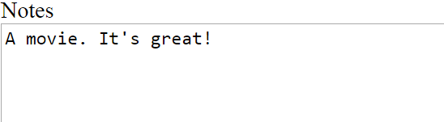

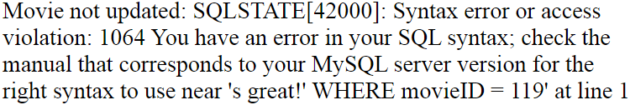
Problem example
Sanitise
UPDATE nc_movie SET notes = 'A movie. It's great!'
Note: other problems that need handling include SQL Injection attacks

Slide 5
PDO prepared statements example
Sanitise
  Instead of this:
  $selectSQL = "SELECT rating FROM r_feedback
  WHERE custID= '$custID'"
  $stmt = $dbConn->query($selectSQL);
  We
  Substitute placeholders for the values
  $selectSQL = "SELECT rating FROM r_feedback
  WHERE custID = :custID"
  Next we prepare the SQL statement and store the result
  $stmt = $dbConn->prepare($selectSQL);
  Then we execute the prepared statement, passing it an array of values to be substituted for the placeholders
  $stmt->execute(array(':custID' => $custID));
Using a
'named' placeholder

Slide 6
Some filter_var filters for sanitising data
Sanitise
FILTER_SANITIZE_EMAIL | Remove all characters except letters, digits and !#$%&'*+-/=?^_`{|}~@.[]
FILTER_SANITIZE_NUMBER_FLOAT | Remove all characters except digits, +- and optionally .,eE
FILTER_SANITIZE_SPECIAL_CHARS | HTML-escape ' " < > & and characters with ASCII value less than 32
FILTER_SANITIZE_STRING | Strip tags, optionally strips or encodes special characters
FILTER_SANITIZE_URL | Remove all characters except letters, digits and $-_.+!*'(),{}|\\^~[]`<>#%";/?:@&=
Source: PHP: Sanitize filters - Manual

Slide 7

Problem example – XSS
Sanitise
Scenario: user 1 enters this post in a message board using their browser which is added as a database record
User 2 wants to view the post in their browser, so the database record is read and rendered in the browser. Problem?
User 2’s browser will be redirected to another page (probably without user 2 knowing)!

Slide 8
Making output safe - tags
Sanitise
Example: preventing a cross-site scripting (XSS) attack
Filter records after they are retrieved from the database and before they are outputted to the browser
Use filter_var and the FILTER_SANITIZE_STRING filter, e.g.
$message = filter_var($message, FILTER_SANITIZE_STRING, FILTER_FLAG_NO_ENCODE_QUOTES);
The value of $message would be sanitised to:
location.href='http://www.somepage.com/spam.php'

